Slide 1
CS461 – RECITATION 09
Machine Learning Principles
Daize Dong
2025-11-10

Slide 2
TODAY’S CONTENT
Support Vector Machines
Practice
  Linear Kernel
  Polynomial Kernel

Slide 3
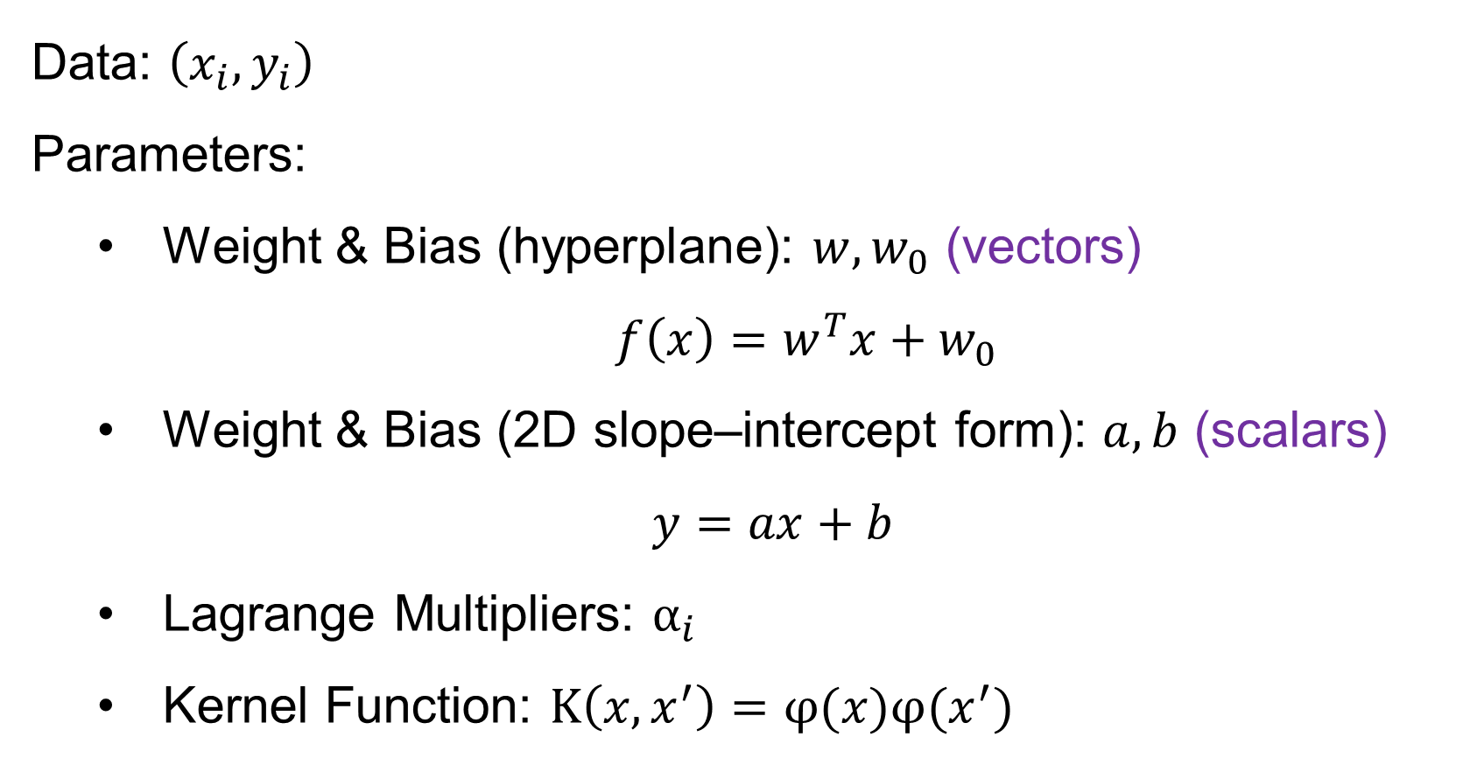
SUPPORT VECTOR MACHINE
Data: $\left(x_{i},y_{i}\right)$
Parameters:
  Weight & Bias (hyperplane): $w,w_{0}$ (vectors)
  $f\left(x\right)=w^{T}x+w_{0}$
  Weight & Bias (2D slope–intercept form): $a,b$ (scalars)
  $y=ax+b$
  Lagrange Multipliers: $α_{i}$
  Kernel Function: $K\left(x,x^{′}\right)=φ(x)φ(x^{′})$

Slide 4
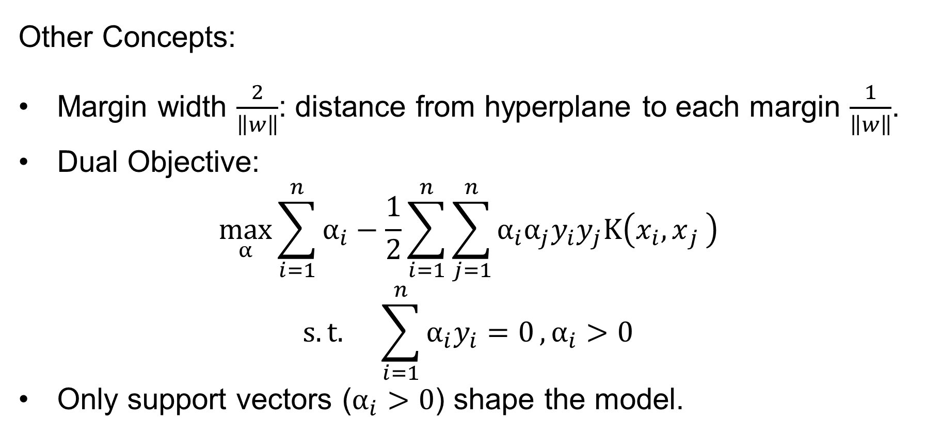
SUPPORT VECTOR MACHINE
Other Concepts:
Margin width $\frac{2}{\left\|w\right\|}$: distance from hyperplane to each margin $\frac{1}{\left\|w\right\|}$.
Dual Objective:
$$\max_{α}{\sum_{i=1}^{n}{α_{i}}−\frac{1}{2}\sum_{i=1}^{n}{\sum_{j=1}^{n}{α_{i}α_{j}y_{i}y_{j}K\left(x_{i}{,x}_{j}\right)}}} \\ s.t. \sum_{i=1}^{n}{α_{i}y_{i}=0},α_{i}>0$$
Only support vectors ($α_{i}>0$) shape the model.

Slide 5
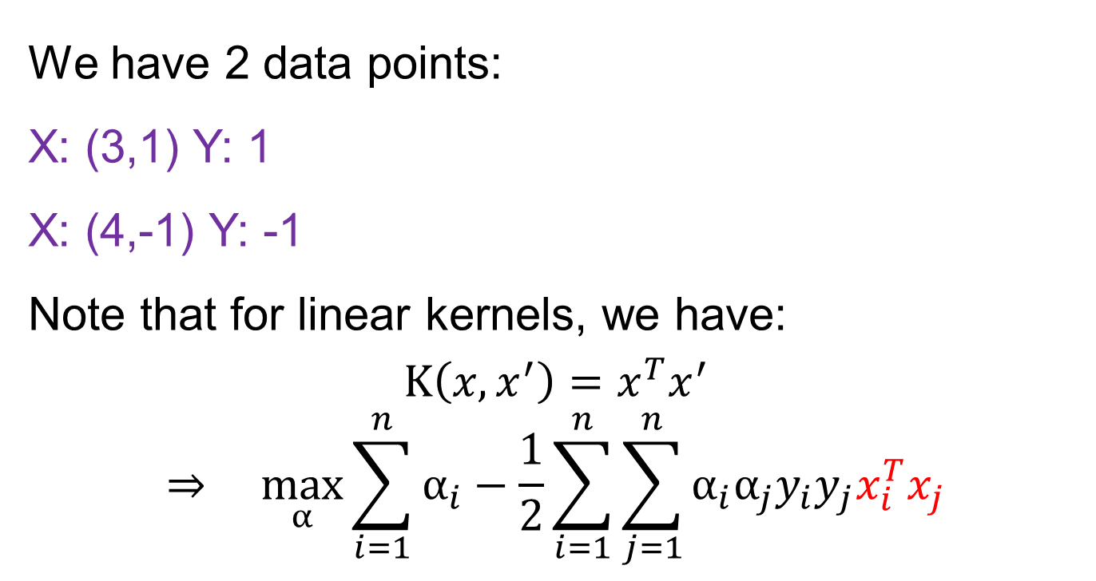
Linear kernel Example
We have 2 data points:
X: (3,1) Y: 1
X: (4,-1) Y: -1
Note that for linear kernels, we have:
$$K\left(x,x^{′}\right)=x^{T}x^{′}$$
$$⇒ \max_{α}{\sum_{i=1}^{n}{α_{i}}−\frac{1}{2}\sum_{i=1}^{n}{\sum_{j=1}^{n}{α_{i}α_{j}y_{i}y_{j}x_{i}^{T}x_{j}}}}$$
1
2

Slide 6
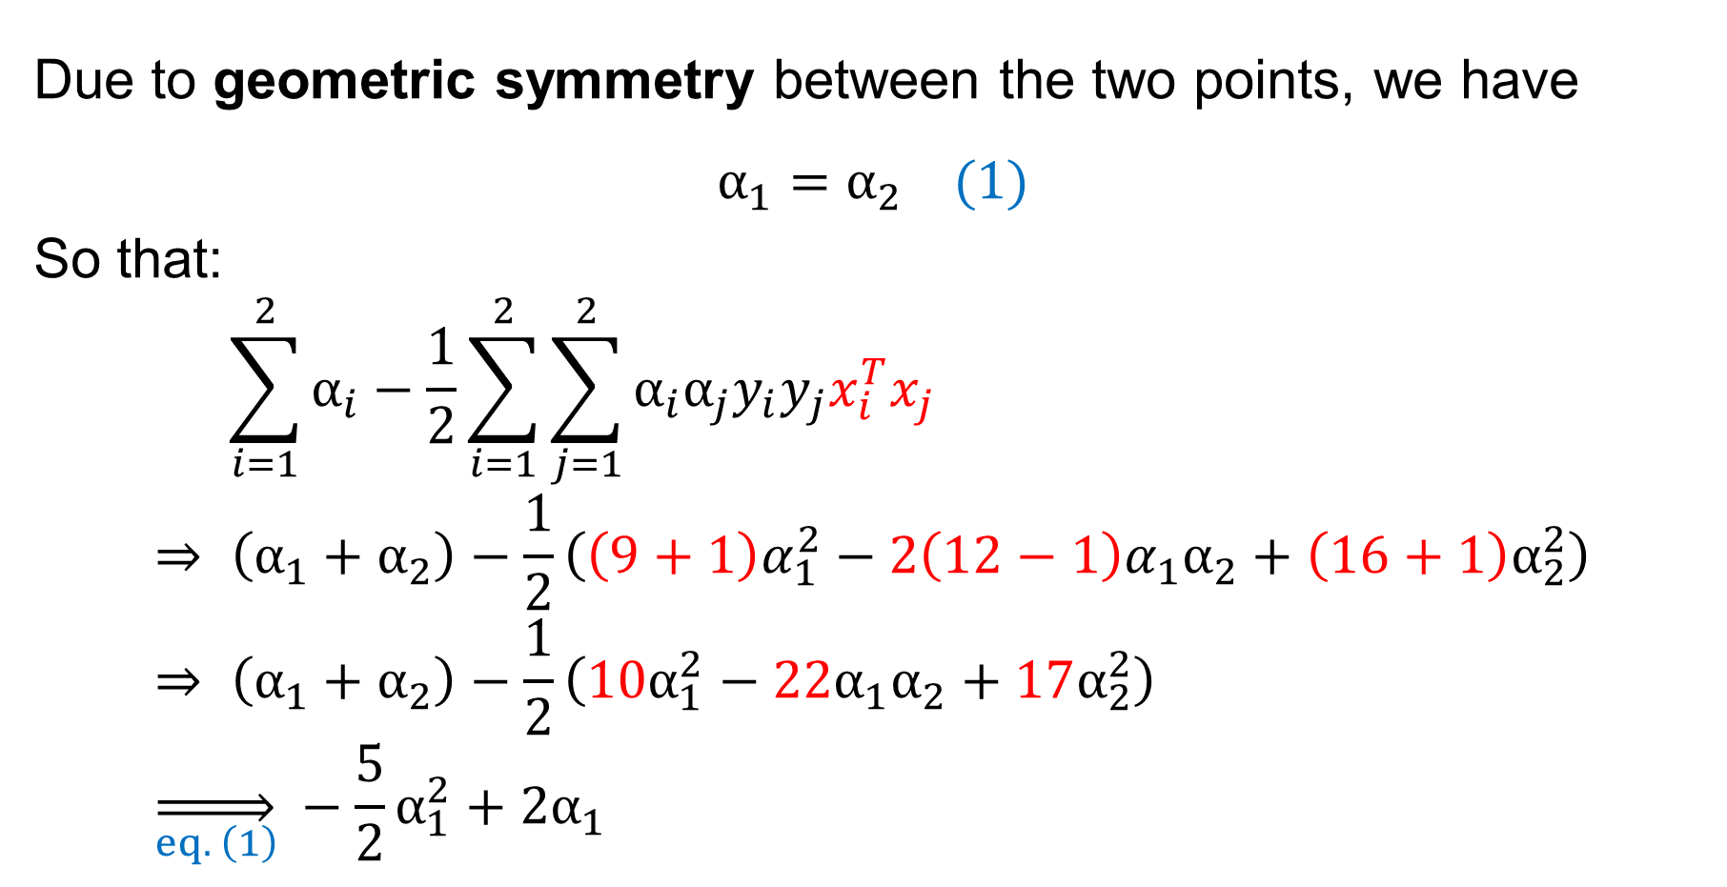

1) Calculate $α_{i}$
X: (3,1) Y: 1
X: (4,-1) Y: -1
Due to geometric symmetry between the two points, we have
$$α_{1}=α_{2} (1)$$
So that:
$$\sum_{i=1}^{2}{α_{i}}−\frac{1}{2}\sum_{i=1}^{2}{\sum_{j=1}^{2}{α_{i}α_{j}y_{i}y_{j}x_{i}^{T}x_{j}}} \\ ⇒ \left(α_{1}+α_{2}\right)−\frac{1}{2}\left({\left(9+1\right)α}_{1}^{2}−{2\left(12−1\right)α}_{1}α_{2}+\left(16+1\right)α_{2}^{2}\right) \\ ⇒ \left(α_{1}+α_{2}\right)−\frac{1}{2}\left({10α}_{1}^{2}−{22α}_{1}α_{2}+17α_{2}^{2}\right) \\ \overset{⇒}{eq. \left(1\right)} −\frac{5}{2}α_{1}^{2}+2α_{1}$$
1
2

Slide 7
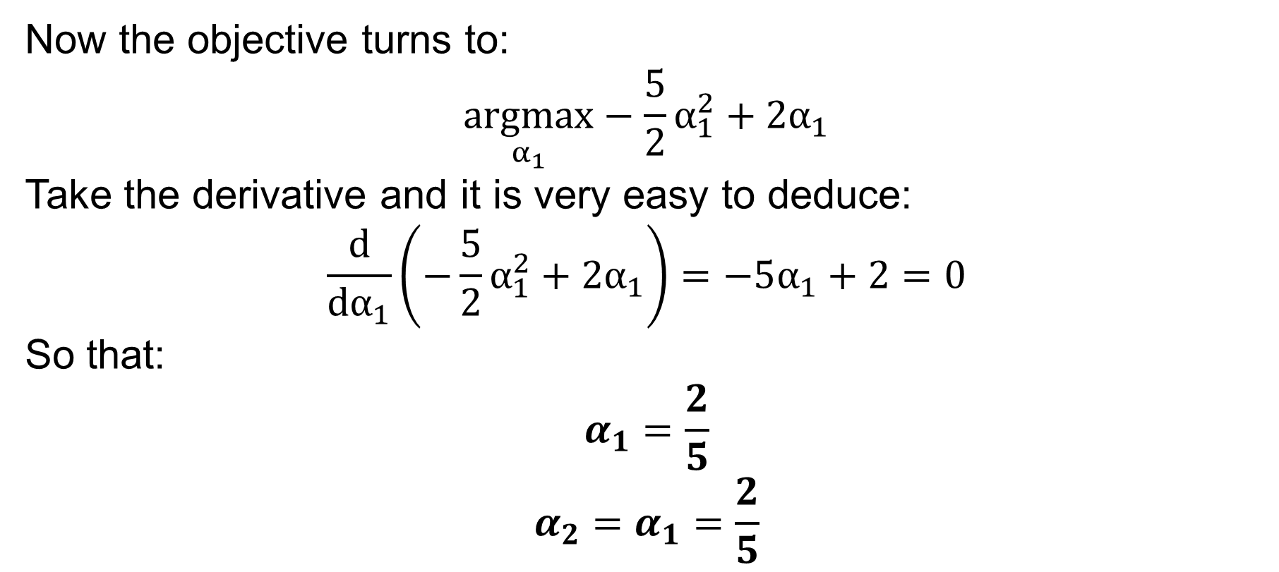
1) Calculate $α_{i}$
X: (3,1) Y: 1
X: (4,-1) Y: -1
Now the objective turns to:
$$\underset{α_{1}}{argmax}−\frac{5}{2}α_{1}^{2}+2α_{1}$$
Take the derivative and it is very easy to deduce:
$$\frac{d}{dα_{1}}\left(−\frac{5}{2}α_{1}^{2}+2α_{1}\right)=−5α_{1}+2=0$$
So that:
$$α_{1}=\frac{2}{5}$$
$$α_{2}=α_{1}=\frac{2}{5}$$

Slide 8
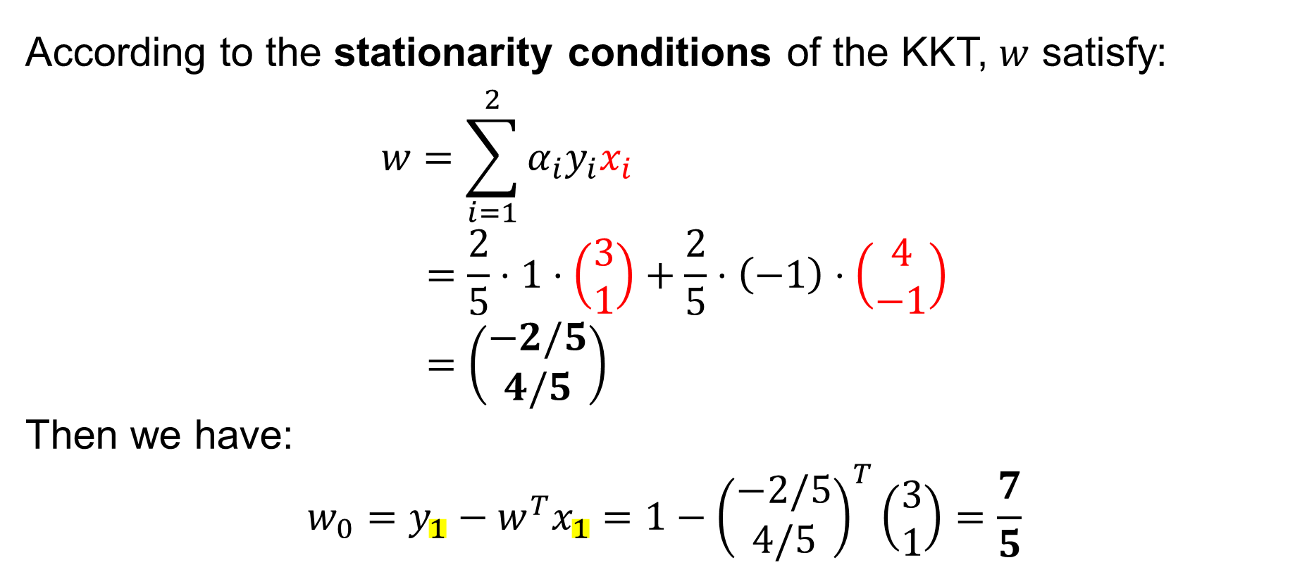


2) solve $w$ and $w_{0}$
X: (3,1) Y: 1
X: (4,-1) Y: -1
According to the stationarity conditions of the KKT, $w$ satisfy:
$$w=\sum_{i=1}^{2}{α_{i}y_{i}x_{i}} \\ =\frac{2}{5}⋅1⋅\left(\begin{matrix}3 \\ 1\end{matrix}\right)+\frac{2}{5}⋅\left(−1\right)⋅\left(\begin{matrix}4 \\ −1\end{matrix}\right) \\ =\left(\begin{matrix}−2/5 \\ 4/5\end{matrix}\right)$$
Then we have:
$$w_{0}=y_{1}−w^{T}x_{1}=1−{\left(\begin{matrix}−2/5 \\ 4/5\end{matrix}\right)}^{T}\left(\begin{matrix}3 \\ 1\end{matrix}\right)=\frac{7}{5}$$
$$α_{1}=\frac{2}{5}$$
$$α_{2}=\frac{2}{5}$$
You can use any support vector here as $x_{i},y_{i}$

Slide 9

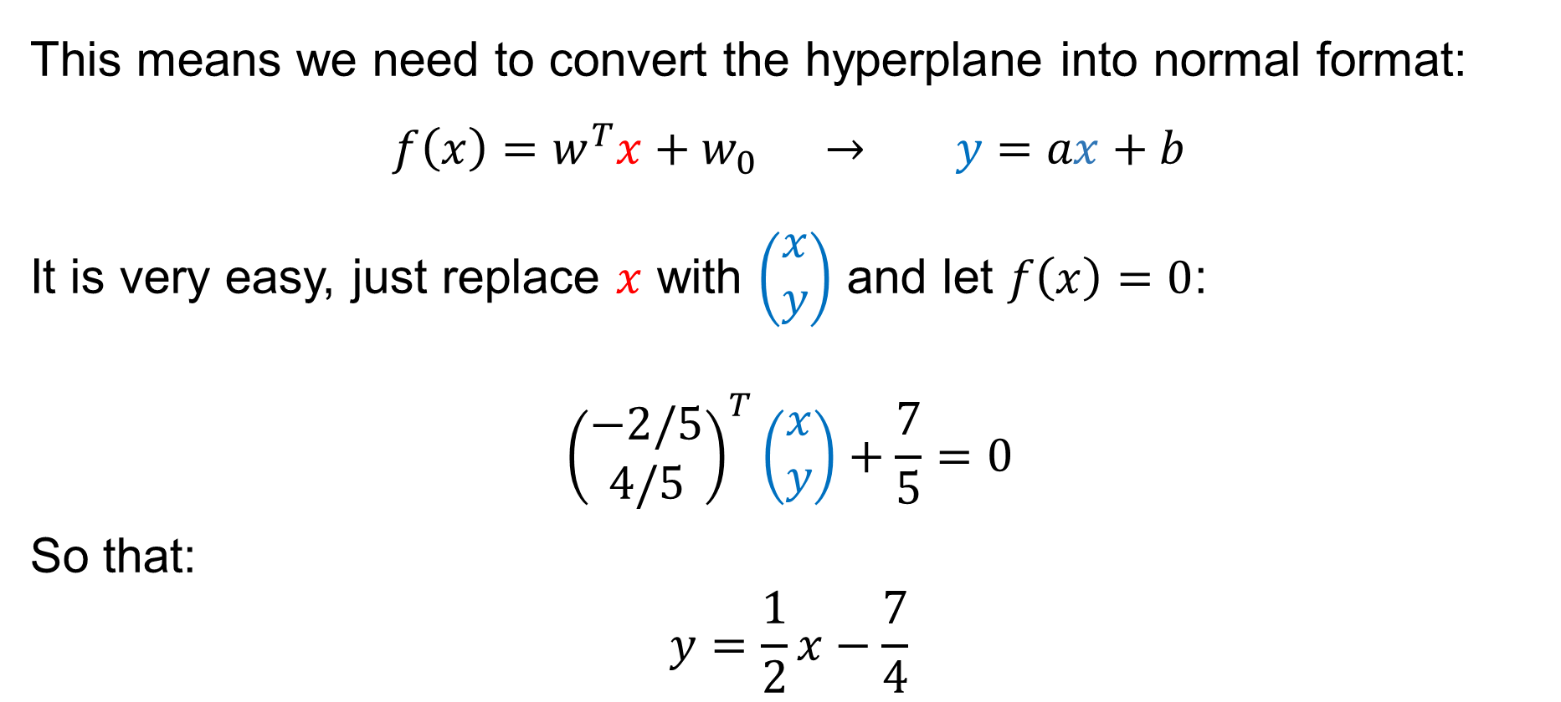
3) Normal linear equation
This means we need to convert the hyperplane into normal format:
$$f\left(x\right)=w^{T}x+w_{0} → y=ax+b$$
It is very easy, just replace $x$ with $\left(\begin{matrix}x \\ y\end{matrix}\right)$ and let $f\left(x\right)=0$:
$${\left(\begin{matrix}−2/5 \\ 4/5\end{matrix}\right)}^{T}\left(\begin{matrix}x \\ y\end{matrix}\right)+\frac{7}{5}=0$$
So that:
$$y=\frac{1}{2}x−\frac{7}{4}$$
$$w=\left(\begin{matrix}−2/5 \\ 4/5\end{matrix}\right)$$
$w_{0}=$ $\frac{7}{5}$

Slide 10



4) Margin size $\frac{1}{\left\|w\right\|}$
Just take $w$ in:
$$\frac{1}{\left\|w\right\|}=\frac{1}{\sqrt{{\left(−\frac{2}{5}\right)}^{2}+{\left(\frac{4}{5}\right)}^{2}}} \\ =\frac{\sqrt{5}}{2}$$
$$w=\left(\begin{matrix}−2/5 \\ 4/5\end{matrix}\right)$$

Slide 11
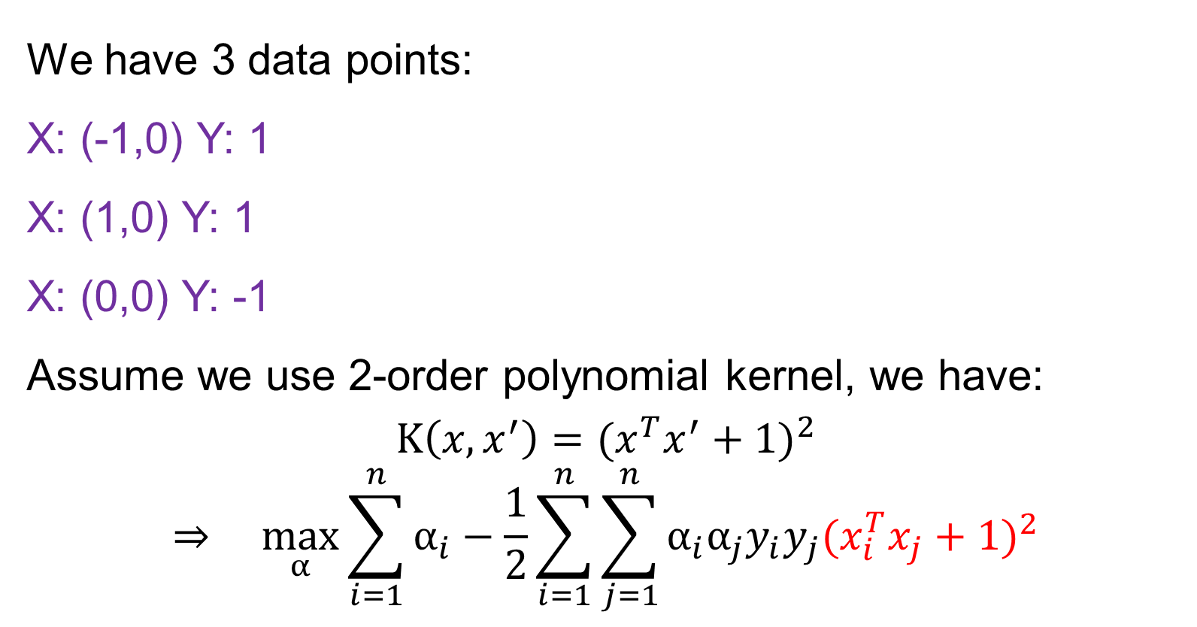
POLYNOMIAL kernel Example
We have 3 data points:
X: (-1,0) Y: 1
X: (1,0) Y: 1
X: (0,0) Y: -1
Assume we use 2-order polynomial kernel, we have:
$$K\left(x,x^{′}\right)={(x^{T}x^{′}+1)}^{2}$$
$$⇒ \max_{α}{\sum_{i=1}^{n}{α_{i}}−\frac{1}{2}\sum_{i=1}^{n}{\sum_{j=1}^{n}{α_{i}α_{j}y_{i}y_{j}{(x_{i}^{T}x_{j}+1)}^{2}}}}$$
1
3
2

Slide 12
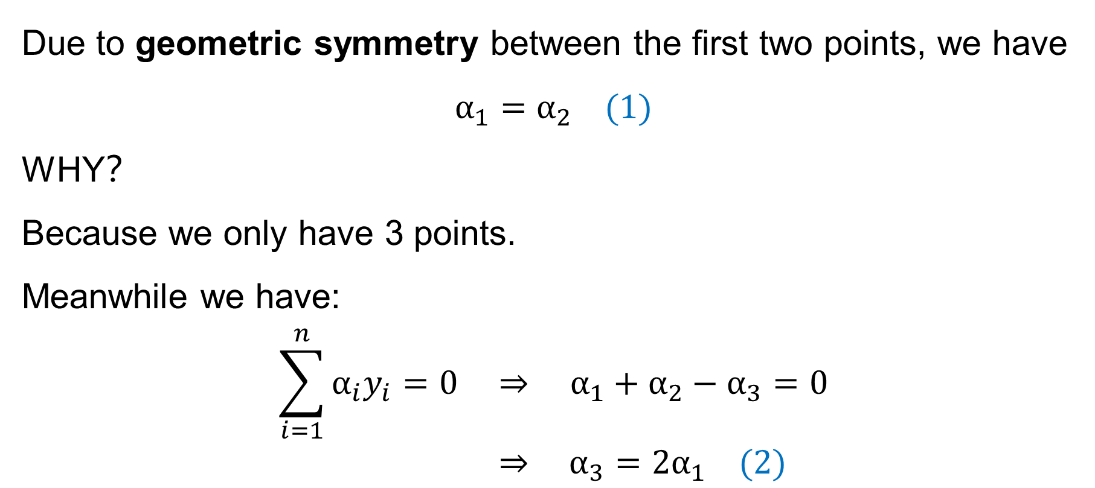
X: (-1,0) Y: 1
X: (1,0) Y: 1
X: (0,0) Y: -1
1) Calculate $α_{i}$
Due to geometric symmetry between the first two points, we have
$$α_{1}=α_{2} (1)$$
WHY？
Because we only have 3 points.
Meanwhile we have:
$$\sum_{i=1}^{n}{α_{i}y_{i}=0 ⇒ α_{1}+α_{2}−α_{3}=0}$$
$$⇒ α_{3}=2α_{1} (2)$$
1
3
2

Slide 13
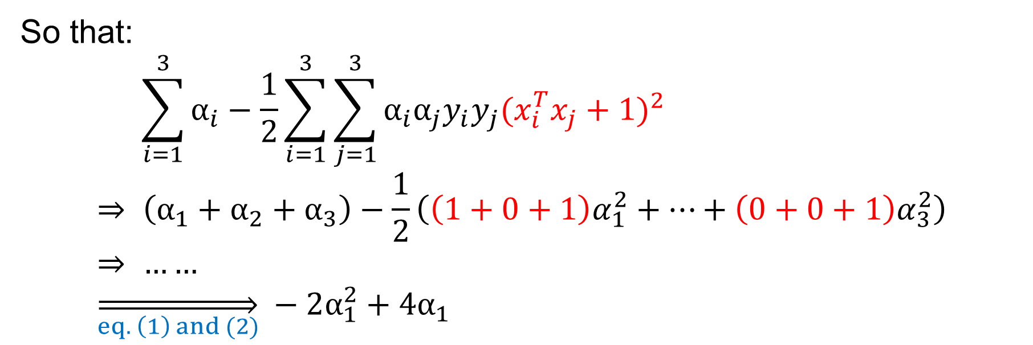

1) Calculate $α_{i}$
X: (-1,0) Y: 1
X: (1,0) Y: 1
X: (0,0) Y: -1
So that:
$$\sum_{i=1}^{3}{α_{i}}−\frac{1}{2}\sum_{i=1}^{3}{\sum_{j=1}^{3}{α_{i}α_{j}y_{i}y_{j}{(x_{i}^{T}x_{j}+1)}^{2}}} \\ ⇒ \left(α_{1}+α_{2}+α_{3}\right)−\frac{1}{2}\left({\left(1+0+1\right)α}_{1}^{2}+…+{\left(0+0+1\right)α}_{3}^{2}\right) \\ ⇒ …… \\ \overset{⇒}{eq. \left(1\right) and (2)} −2α_{1}^{2}+4α_{1}$$
$$α_{2}=α_{1}$$
$$α_{3}=2α_{1}$$

Slide 14
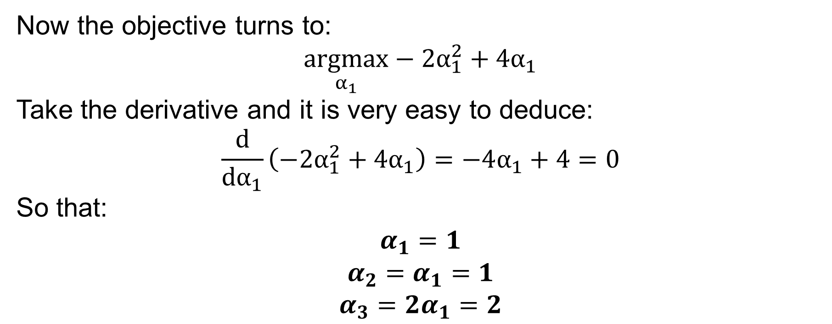
1) Calculate $α_{i}$
X: (-1,0) Y: 1
X: (1,0) Y: 1
X: (0,0) Y: -1
Now the objective turns to:
$$\underset{α_{1}}{argmax}−2α_{1}^{2}+4α_{1}$$
Take the derivative and it is very easy to deduce:
$$\frac{d}{dα_{1}}\left(−2α_{1}^{2}+4α_{1}\right)=−4α_{1}+4=0$$
So that:
$$α_{1}=1$$
$$α_{2}=α_{1}=1$$
$$α_{3}={2α}_{1}=2$$

Slide 15
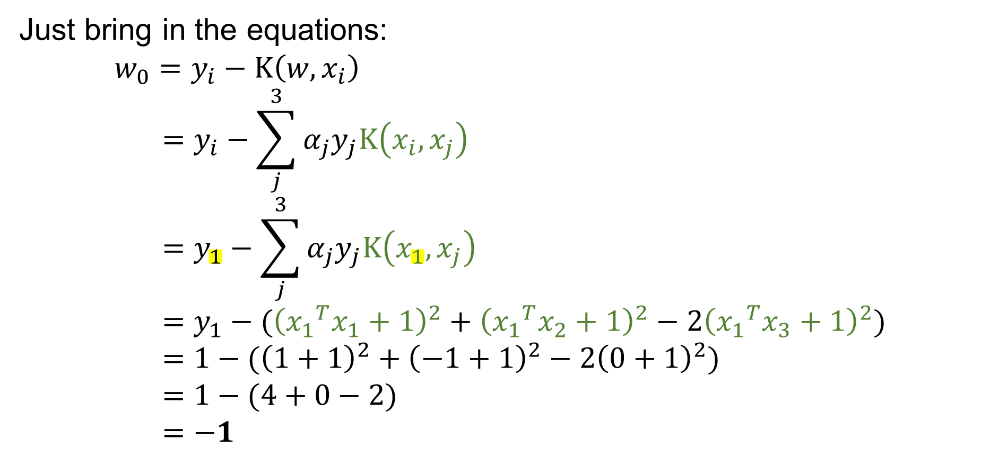



2) solve $w_{0}$
X: (-1,0) Y: 1
X: (1,0) Y: 1
X: (0,0) Y: -1
Just bring in the equations:
$$w_{0}=y_{i}−K\left(w,x_{i}\right) \\ =y_{i}−\sum_{j}^{3}{{α_{j}y}_{j}K\left(x_{i},x_{j}\right)} \\ =y_{1}−\sum_{j}^{3}{{α_{j}y}_{j}K\left(x_{1},x_{j}\right)} \\ =y_{1}−({\left({x_{1}}^{T}x_{1}+1\right)}^{2}+{\left({x_{1}}^{T}x_{2}+1\right)}^{2}−2{\left({x_{1}}^{T}x_{3}+1\right)}^{2}) \\ =1−({\left(1+1\right)}^{2}+{\left(−1+1\right)}^{2}−2{\left(0+1\right)}^{2}) \\ =1−(4+0−2) \\ =−1$$
$$w=\sum_{j}^{3}{{α_{j}y}_{j}φ(x_{j})}$$
$$wφ(x_{i})=\sum_{j}^{3}{{α_{j}y}_{j}φ(x_{j})φ(x_{i})}$$
$$K\left(w,x_{i}\right)=\sum_{j}^{3}{{α_{j}y}_{j}K\left(x_{i},x_{j}\right)}$$
$$α_{1}=1$$
$$α_{2}=1$$
$$α_{3}=2$$
You can use any support vector here as $x_{i},y_{i}$

